Slide 1

ALGORITMA DAN PEMROGRAMAN
CSF101
Sesi 1
Introduction to algoritma

Slide 2
Penilaian
Kehadiran = 10%
UTS = 10%
UAS = 10%
Quis = 10%
Tugas = 10%
Project Akhir = 50%

Slide 3
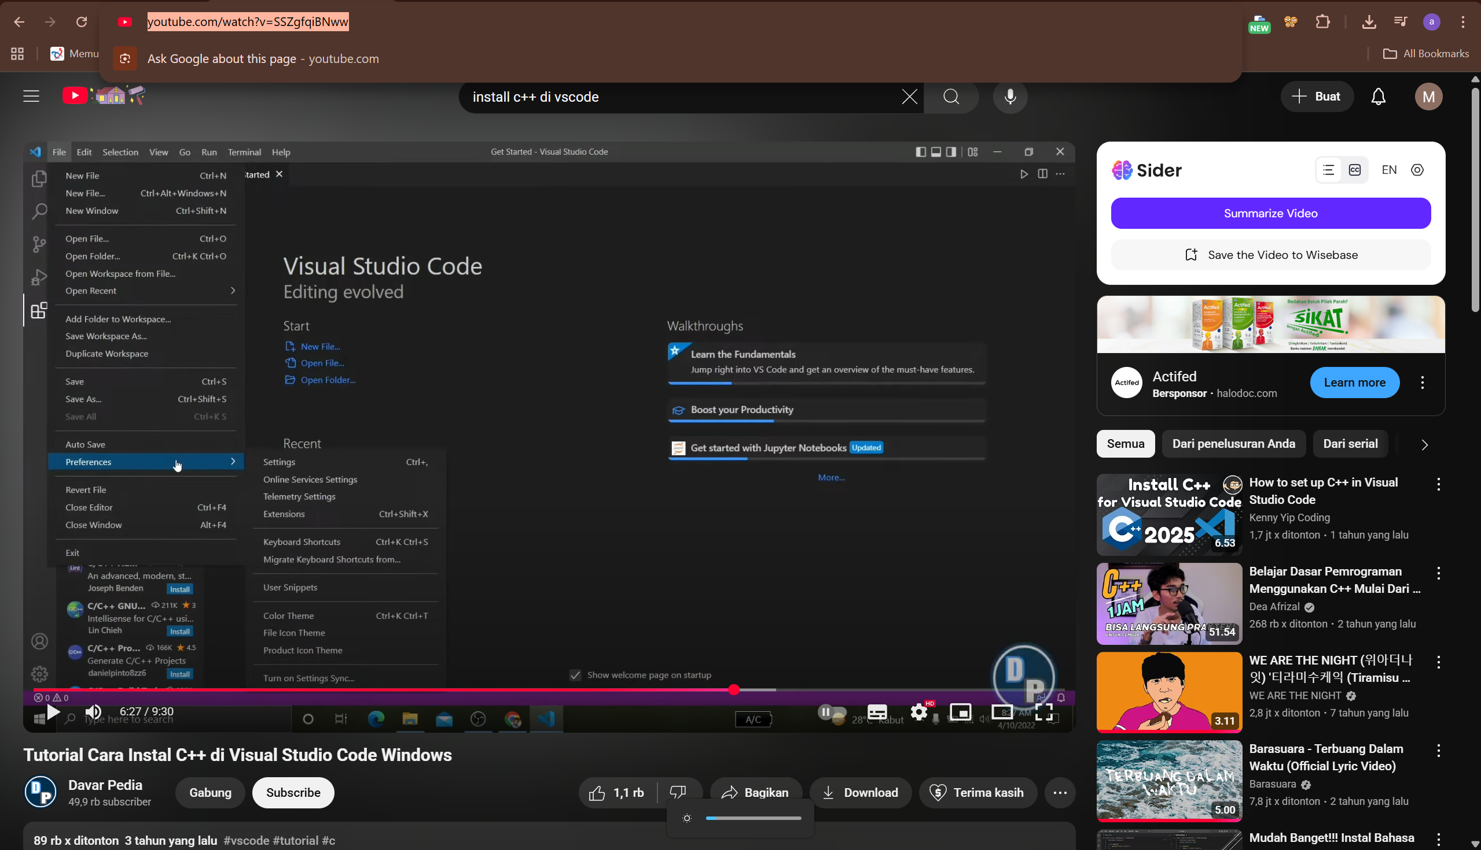
Installasi C++
https://www.youtube.com/watch?v=SSZgfqiBNww

Slide 4

Compiler

Slide 5
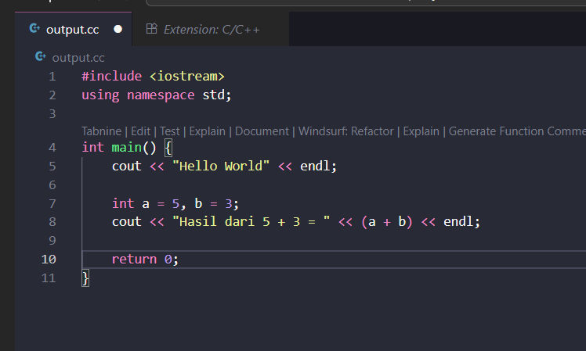
Penulisan (Output)

Slide 6
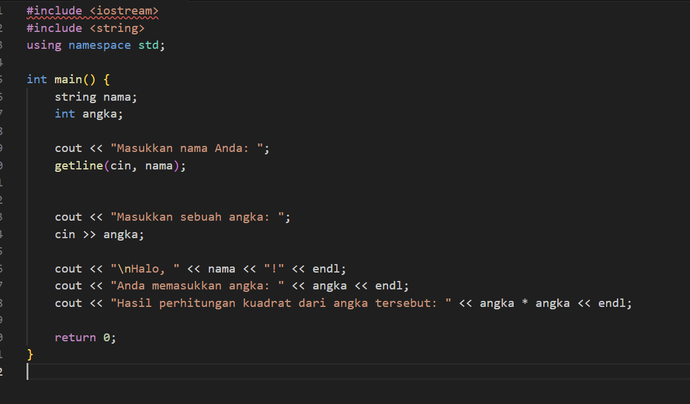
Pembacaan (input)

Slide 7
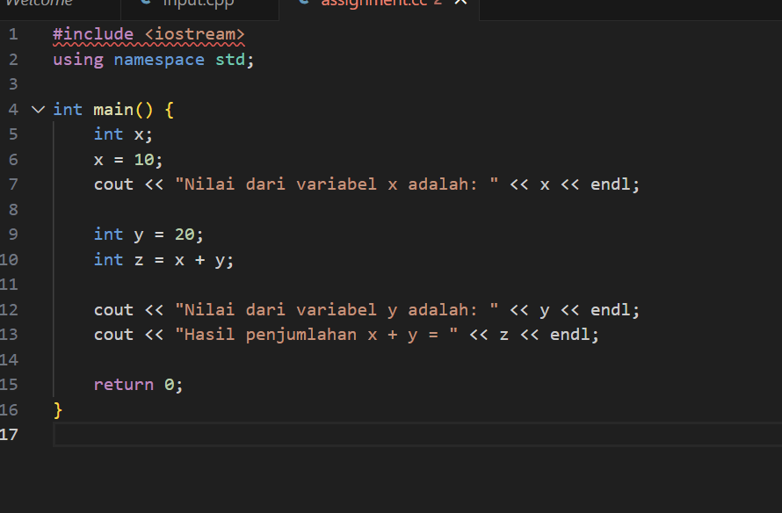
Pemuatan (Assignment)

Slide 8
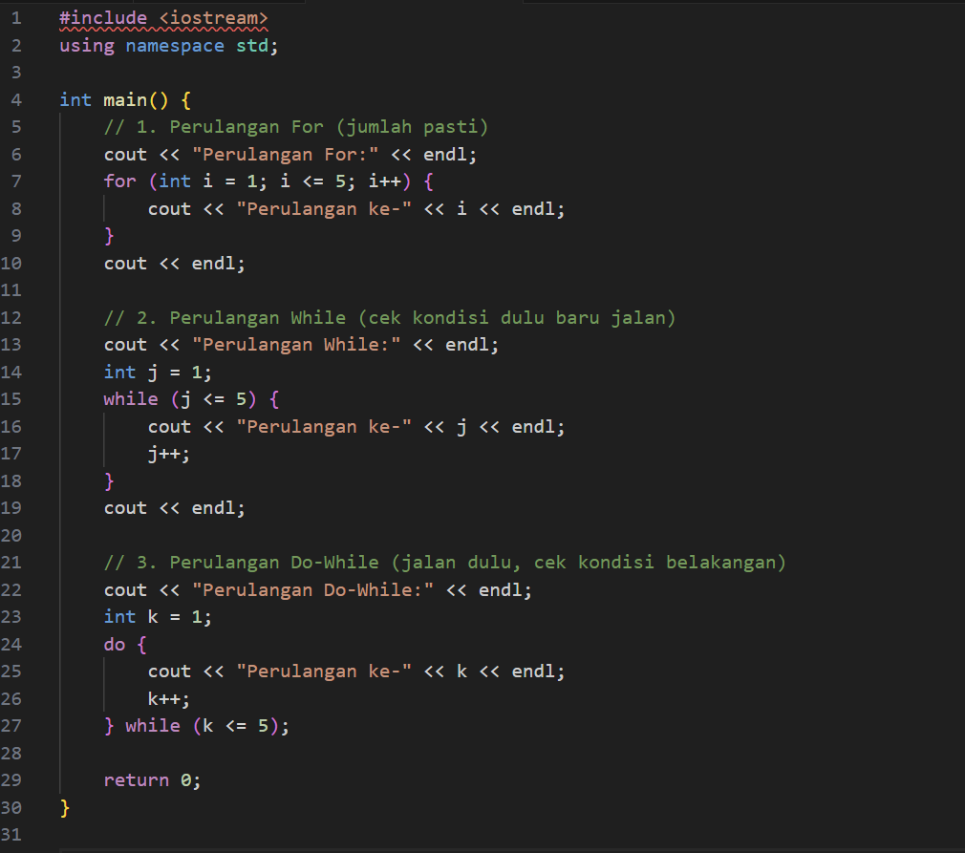
Perulangan (Looping)

Slide 9
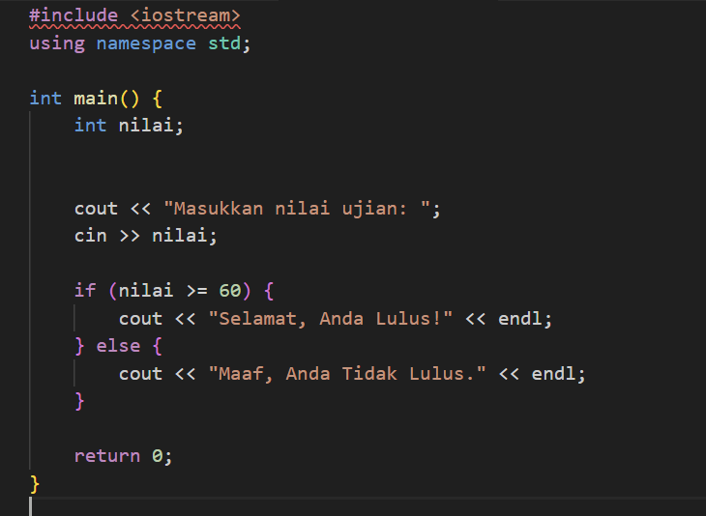
Pengkondisian (if-else)

Slide 10
Source code
https://github.com/arhan321/CSF101-algoritma_dan_pemrograman

Slide 11

Any Question

Slide 12
Terima Kasih

